Slide 1

SousChef
Pitch Deck
Albini Luca
Baldini Daniele
Cataneo Riccardo
Epis Luca
Trapletti Andrea
1096133
1089818
1065599
1067898
1066781

Slide 2
Problem Definition
Whether we’re talking about a typical full service restaurant or a pizzeria, one of the most important challenges that this kind of business has to face is reducing food waste. According to the European Commission, every year in Europe restaurants waste 5.319mln tons of food,12kg per inhabitant. A study conducted by LUMSA University and RomaTre University showed that the 45% of this waste is due to inefficiencies within kitchens during the food preparation phase. Although in almost all cases restaurateurs and chefs are well aware of this and the impact it has on their business, they find themselves having to manage the situation without appropriate tools.
Source: Spreco alimentare, è ora di combatterlo. Il food sharing ci aiuterà. – Cimas Ristorazione. (s.d.). Cimas Ristorazione.
Food Waste. (s.d.). European Commission.

Slide 3
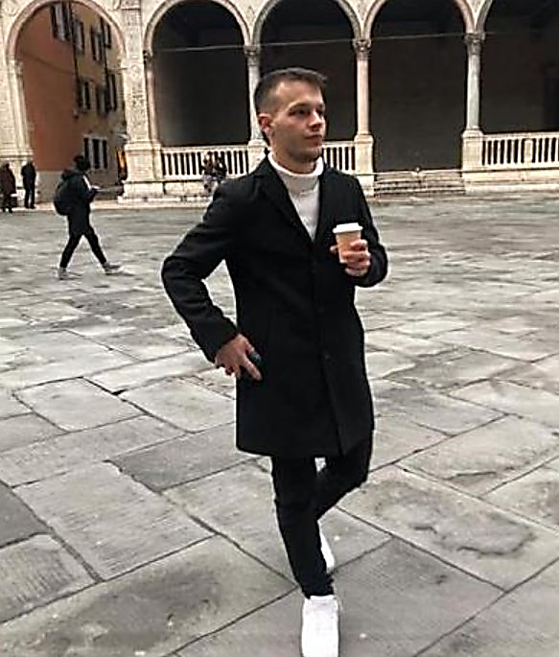

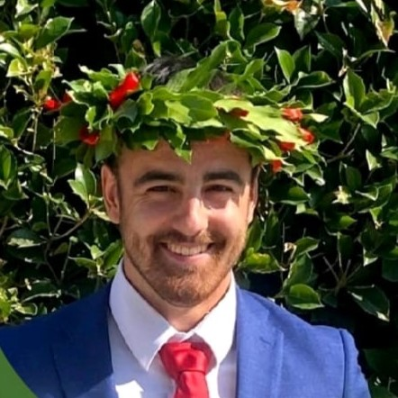
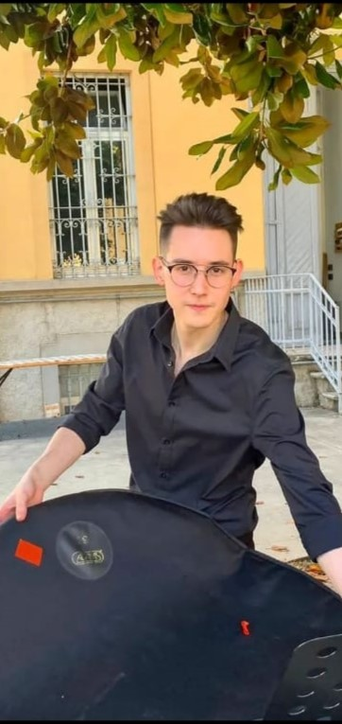


Team
To solve this problem, we formed a team of young engineers.
For more details check the Team Canvas in Appendix (slide 86).
Andrea Trapletti
Team Leader

Slide 4

Team
To solve this problem, we formed a team of young engineers.
For more details check the Team Canvas in Appendix (slide 86).
Daniele Baldini
Technical Lead

Slide 5
Team
To solve this problem, we formed a team of young engineers.
For more details check the Team Canvas in Appendix (slide 86).
Riccardo Cataneo
Researcher

Slide 6
Team
To solve this problem, we formed a team of young engineers.
For more details check the Team Canvas in Appendix (slide 86).
Luca Epis
Content Creator

Slide 7
Team
To solve this problem, we formed a team of young engineers.
For more details check the Team Canvas in Appendix (slide 86).
Luca Albini
Quality Assurance

Slide 8
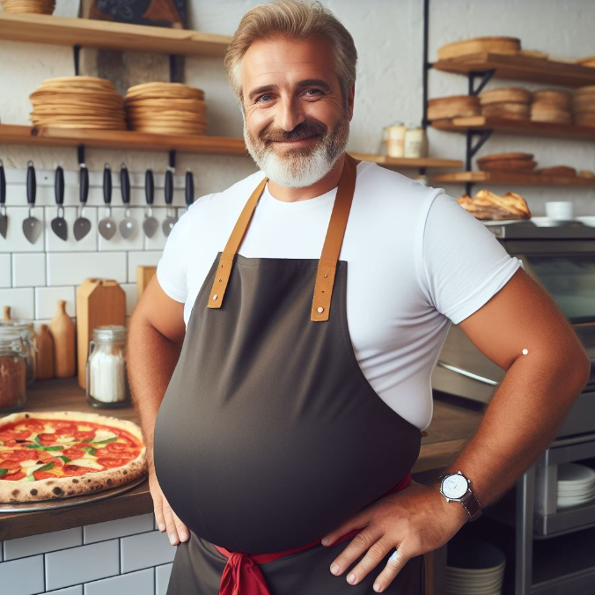

Persona
Gaetano Esposito is a 46-year-old pizza chef who lives in Naples with his wife Antonietta and their son Calogero. Since he was young, he has worked in the restaurant industry, learning the trade from the greatest Neapolitan chefs. Compared to the restaurant where he worked in previous years, Gaetano has noticed that, despite a similar number of covers and customer flow, his restaurant consumes more resources than necessary and has a higher amount of waste.
His goal is to maintain low prices for his dishes despite the recent increase in expenses.
First, user personas of the end users were developed to create a tailored solution through a clearer understanding of their needs and goals. To encompass the entire spectrum of possible customers in the analysis, two types of restaurateurs at opposite ends were considered.

Slide 9
Persona
Gaetano Esposito is a 46-year-old pizza chef who lives in Naples with his wife Antonietta and their son Calogero. Since he was young, he has worked in the restaurant industry, learning the trade from the greatest Neapolitan chefs. Compared to the restaurant where he worked in previous years, Gaetano has noticed that, despite a similar number of covers and customer flow, his restaurant consumes more resources than necessary and has a higher amount of waste.
His goal is to maintain low prices for his dishes despite the recent increase in expenses.

Slide 10
Persona
Gaetano Esposito is a 46-year-old pizza chef who lives in Naples with his wife Antonietta and their son Calogero. Since he was young, he has worked in the restaurant industry, learning the trade from the greatest Neapolitan chefs. Compared to the restaurant where he worked in previous years, Gaetano has noticed that, despite a similar number of covers and customer flow, his restaurant consumes more resources than necessary and has a higher amount of waste.
His goal is to maintain low prices for his dishes despite the recent increase in expenses.
Giulia Colombo is a young entrepreneur from Milan, she lives with her cat Romeo in the Lambrate area and has studied psychology. After a few years of apprenticeship, she realized that her true passion is in the restaurant industry, so she decided to open her own vegan bistrot. The high energy costs and rising rental prices in Milan are putting Giulia's business to the test. For this reason, and to reduce her carbon footprint, she would like to make her bistro more efficient.
Giulia's goal is to offer vegan cuisine with sustainable products at an affordable price.

Slide 11
Persona
Gaetano Esposito is a 46-year-old pizza chef who lives in Naples with his wife Antonietta and their son Calogero. Since he was young, he has worked in the restaurant industry, learning the trade from the greatest Neapolitan chefs. Compared to the restaurant where he worked in previous years, Gaetano has noticed that, despite a similar number of covers and customer flow, his restaurant consumes more resources than necessary and has a higher amount of waste.
His goal is to maintain low prices for his dishes despite the recent increase in expenses.
Giulia Colombo is a young entrepreneur from Milan, she lives with her cat Romeo in the Lambrate area and has studied psychology. After a few years of apprenticeship, she realized that her true passion is in the restaurant industry, so she decided to open her own vegan bistrot. The high energy costs and rising rental prices in Milan are putting Giulia's business to the test. For this reason, and to reduce her carbon footprint, she would like to make her bistro more efficient.
Giulia's goal is to offer vegan cuisine with sustainable products at an affordable price.

Slide 12



Customer Development
After defining the "typical customer," we conducted interviews with chefs and restaurant owners who fall within the spectrum of potential clients defined through the user personas. The goal was to gain a deeper understanding of the challenges restaurateurs face, specifically in terms of efficiency and sustainability.
CHEF x4
Interviews
Link
OWNER x1

Slide 13
Customer Development
The insights gathered by the interviews allowed us to develop the following key points:
1
Suppliers not interested into sustainability issues
2
Employee training
3
Increasing overall operational and energy efficiency of the venue
4
Avoiding food waste

Slide 14
Customer Development
The insights gathered by the interviews allowed us to develop the following key points:
1
Suppliers not interested into sustainability issues
2
Employee training
3
Increasing overall operational and energy efficiency of the venue
4
Avoiding food waste

Slide 15

Customer Development
The insights gathered by the interviews allowed us to develop the following key points:
2
Employee training
1
Suppliers not interested into sustainability issues
3
Increasing overall operational and energy efficiency of the venue
The interviews revealed that the suppliers working with the interviewees have little interest in the issue of environmental sustainability. For this reason, we decided to create a solution specifically designed for individual restaurant businesses, excluding their suppliers.
4
Avoiding food waste

Slide 16

Customer Development
The insights gathered by the interviews allowed us to develop the following key points:
3
Increasing overall operational and energy efficiency of the venue
2
Employee training
4
One of the issues highlighted, particularly by the chefs, concerns the difficulty in finding qualified personnel. This necessitates a learning-by-doing approach, meaning that new hires are taught how to perform their job during service, resulting in time loss and inefficiency. In other cases, training is conducted by third parties, adding further costs. Given the importance of this problem, it was considered from the start in the product developement process.
Avoiding food waste

Slide 17
Customer Development
The insights gathered by the interviews allowed us to develop the following key points:
4
Avoiding food waste
3
Increasing overall operational and energy efficiency of the venue
The lack of qualified and well-organized personnel also affects kitchen management. Inexperience and disorganization, caused by a lack of experience, inevitably lead to a chaotic and inefficient work environment. According to the interviewees, having a valuable staff is a must, especially because it is essential for team-building and for operating efficiently. In particular, organization and task division in the kitchen are keys for an efficient workplace, which has made this validated problem one of the main focuses in the subsequent phases.

Slide 18
Customer Development
The insights gathered by the interviews allowed us to develop the following key points:
4
Avoiding food waste
The creation of waste is one of the consequences of operational inefficiency in restaurant kitchens. The interviewed chefs and restaurateurs are aware of the problem and its severity, and for this reason, some have already implemented solutions that allow them to manage the generated waste but not eliminate the problem at its source. This aspect also played a fundamental role in the development of the solution.

Slide 19

Solutions
To address the issues identified with the help of the interviewed industry experts, the following solutions have been devised:
Computer Vision
Computer vision systems are systems that acquire, process, and understand digital images or videos to automate tasks that typically require human vision. In our case, this technology will address the challenges of employee training and increasing overall operational efficiency of the venue.

Slide 20
Solutions
To address the issues identified with the help of the interviewed industry experts, the following solutions have been devised:
Computer Vision
Computer vision systems are systems that acquire, process, and understand digital images or videos to automate tasks that typically require human vision. In our case, this technology will address the challenges of employee training and increasing overall operational efficiency of the venue.
Regarding the improvement of energy efficiency, the intention is to address it in future implementations.

Slide 21
Solutions
To address the issues identified with the help of the interviewed industry experts, the following solutions have been devised:
Pre-ordering
The increase in operativity and the staff training lead to better results in terms of food waste as well. In addition to this, through an interview with a restaurateur, it was decided to implement a pre-ordering system. This feature allows the restaurant customer to order the dishes they wish to consume in advance, in exchange for a discount.

Slide 22
Value Proposition
Following the validation of the issues and needs that characterize the target market, the startup's value proposition has been defined.
Our: Software solution for restaurant management powered by computer vision and an innovative pre-ordering system for customers,
Helps: full service restaurants' owners,
Who wants to: Improve staff performance and minimize food waste during the food preparation phase,

Slide 23
Value Proposition
Following the validation of the issues and needs that characterize the target market, the startup's value proposition has been defined.
By: Avoiding high investment of time and money in staff training and, furthermore, reducing the impact of high raw materials cost on profit,
And: increasing awareness about the optimal amount of food to be prepared via anticipated insights on the reservation and enhancing operational efficiency,
Unlike: traditional once-in-a-while in person consultancy services, that don't easily adapt to changes in the staff and menu.

Slide 24

Riskiest assumptions
During the development of the solutions, serveral hypothesis were formulated and then classified based on the risk, that is characterized by the level of uncertainty and impact.
Our customers are used to use apps to reserve tables
The new generations are accustomed to booking online
Probability
Impact

Slide 25
Riskiest assumptions
During the development of the solutions, serveral hypothesis were formulated and then classified based on the risk, that is characterized by the level of uncertainty and impact.
People are interested in deciding beforehand what to eat
Staff members will be able to keep up to optimal work pace suggested by the software
Consultancy report reviewing activity at the end of service won't take much time from staff
Restaurant owners who intend to use consulting software likely have no issues creating an online menu and managing reservations through the software
Probability
Impact

Slide 26
Riskiest assumptions
During the development of the solutions, serveral hypothesis were formulated and then classified based on the risk, that is characterized by the level of uncertainty and impact.
Customers will adopt the new pre-ordering system
Every kitchen is suitable for the installation of the computer vision system.
The impact of reducing food waste will have a significant cost impact.
Restaurants owners are ready to partially put tradition aside
Restaurant owners are willing to pay for this service
The restaurant owner gains an important economic advantage by knowing in advance what the client wants to order
Being an italian restaurant based startup, we'll have an important customer base
we will be given access to restaurant space to install the computer vision device
Probability
Impact

Slide 27
To reduce the possibility of making mistakes, we formulated questions to validate the riskiest assumptions.
Interview
Riskiest assumptions
During the development of the solutions, serveral hypothesis were formulated and then classified based on the risk, that is characterized by the level of uncertainty and impact.
Staff training via video be as effective as in-person training
Restaurants are interested in reducing wastes
Restaurant owners will trust computer vision analysis
Computer Vision Privacy Issues
By having an economic saving due to food waste reduction the foods ordered beforehand could be discounted
Probability
Impact

Slide 28
To reduce the possibility of making mistakes, we formulated questions to validate the riskiest assumptions.
Interview
During the development of the solutions, serveral hypothesis were formulated and then classified based on the risk, that is characterized by the level of uncertainty and impact.
Staff training via video be as effective as in-person training
Restaurants are interested in reducing wastes
Restaurant owners will trust computer vision analysis
Computer Vision Privacy Issues
By having an economic saving due to food waste reduction the foods ordered beforehand could be discounted
Probability
Impact
How much does food waste impact costs?
Are you willing to offer discounts on menu ordered beforhand?
Would you install a computer vision system in your restaurant?

Slide 29
To reduce the possibility of making mistakes, we formulated questions to validate the riskiest assumptions.
Interview
During the development of the solutions, serveral hypothesis were formulated and then classified based on the risk, that is characterized by the level of uncertainty and impact.
Staff training via video be as effective as in-person training
Restaurants are interested in reducing wastes
Restaurant owners will trust computer vision analysis
Computer Vision Privacy Issues
By having an economic saving due to food waste reduction the foods ordered beforehand could be discounted
Probability
Impact
Would you trust an AI system to train your staff? How much time do your employees spend on training?
Would the staff agree to be recorded by cameras?

Slide 30




Evidences
The second interview led us to the following conclusions
The use of cameras capable of recognizing individual employees and the mistakes they make could lead to privacy issues as well as reluctance from the employees themselves to work in such an environment.
It would be difficult, at least initially, to rely EXCLUSIVELY on a computer vision tool for employee training, but they recognize our solution as a valuable support tool.
The interviewees consider offering discounts to customers a good compromise to have the orders in advance available.
The interviewees are aware that waste significantly impacts their business and are interested in reducing it.

Slide 31
Evidences
The second interview led us to the following conclusions
The use of cameras capable of recognizing individual employees and the mistakes they make could lead to privacy issues as well as reluctance from the employees themselves to work in such an environment.
It would be difficult, at least initially, to rely EXCLUSIVELY on a computer vision tool for employee training, but they recognize our solution as a valuable support tool.
The interviewees consider offering discounts to customers a good compromise to have the orders in advance available.
The interviewees are aware that waste significantly impacts their business and are interested in reducing it.

Slide 32
Evidences
The second interview led us to the following conclusions
The use of cameras capable of recognizing individual employees and the mistakes they make could lead to privacy issues as well as reluctance from the employees themselves to work in such an environment.
It would be difficult, at least initially, to rely EXCLUSIVELY on a computer vision tool for employee training, but they recognize our solution as a valuable support tool.
The interviewees consider offering discounts to customers a good compromise to have the orders in advance available.
The interviewees are aware that waste significantly impacts their business and are interested in reducing it.

Slide 33
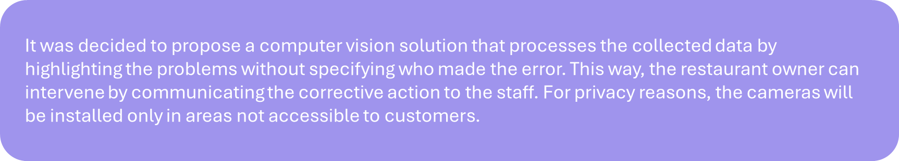
Evidences
The second interview led us to the following conclusions
The use of cameras capable of recognizing individual employees and the mistakes they make could lead to privacy issues as well as reluctance from the employees themselves to work in such an environment.
It would be difficult, at least initially, to rely EXCLUSIVELY on a computer vision tool for employee training, but they recognize our solution as a valuable support tool.
The interviewees consider offering discounts to customers a good compromise to have the orders in advance available.
The interviewees are aware that waste significantly impacts their business and are interested in reducing it.

Slide 34
Evidences
The second interview led us to the following conclusions
The use of cameras capable of recognizing individual employees and the mistakes they make could lead to privacy issues as well as reluctance from the employees themselves to work in such an environment.
It would be difficult, at least initially, to rely EXCLUSIVELY on a computer vision tool for employee training, but they recognize our solution as a valuable support tool.
It was decided to propose a computer vision solution that processes the collected data by highlighting the problems without specifying who made the error. This way, the restaurant owner can intervene by communicating the corrective action to the staff. For privacy reasons, the cameras will be installed only in areas not accessible to customers.
The interviewees consider offering discounts to customers a good compromise to have the orders in advance available.
The interviewees are aware that waste significantly impacts their business and are interested in reducing it.

Slide 35
Prototype v1.0
After concluding the customer development phase, the first version of the prototype was built, keeping in mind the critical issues highlighted in the previous interviews. The first version of the prototype was structured as follows:
Once logged into the platform using the credentials provided by the team, the user can access four sections:
Analytics
Menu
Staff
Orders

Slide 36
Prototype v1.0
After concluding the customer development phase, the first version of the prototype was built, keeping in mind the critical issues highlighted in the previous interviews. The first version of the prototype was structured as follows:
After concluding the customer development phase, the first version of the prototype was built, keeping in mind the critical issues highlighted in the previous interviews. The first version of the prototype was structured as follows:
Once logged into the platform using the credentials provided by the team, the user can access four sections:
Analytics
Menu
Staff
Orders

Slide 37
Prototype v1.0
After concluding the customer development phase, the first version of the prototype was built, keeping in mind the critical issues highlighted in the previous interviews. The first version of the prototype was structured as follows:
In this section, you can consult the daily, weekly, and monthly logs of issues detected by the computer vision system. For each issue, the date and time, type of issue, area (different rooms, kitchen...), and a possible solution calculated by the artificial intelligence are reported.
Once logged into the platform using the credentials provided by the team, the user can access four sections:
Analytics
Menu
Staff
Orders

Slide 38
Prototype v1.0
From here, it is possible to manage staff availability by marking the date and shift during which each employee works. Other than being a useful management tool for the owner (or the person in charge of staff), it is essential for the computer vision system to understand how many people are present (or should be present) at the workplace.
Analytics
Menu
Staff
Orders

Slide 39
Prototype v1.0
In the menu section, it is possible to divide the dishes on the menu into four different categories: appetizers, first courses, main courses, and side dishes.
For each dish, it is also possible to view the ingredients that compose it. This functionality, besides being useful for the staff, helps the computer vision system to better manage the quantity of products to keep "in stock" and to monitor the quantities used within each dish. In the prototype, it is possible to see the ingredients only for the pasta alla carbonara to give an idea of how the software works. Using the "Edit" button, it is possible to make changes to the menu, such as adding or removing dishes and their respective ingredients (a functionality currently not available in the prototype).
Analytics
Menu
Staff
Orders

Slide 40
Prototype v1.0
In this last section, it is possible to view the anticipated orders placed by customers through the restaurant's web page. The software system can create predictive statistics regarding the amount of food that will be consumed during the shift, which will be monitored by the computer vision system.
Analytics
Menu
Staff
Orders

Slide 41
Testing
To further improve the quality of the prototype, we conducted tests involving 12 industry experts. To create the test, we started from the following statement:
Hypothesis: we believe that the "suggested solution" section is easy to find and to understandable
Test: to verify that, we will create a scenario in which the user has to find the solution to the starting problem
Metric: and measure how many minutes it takes to achieve the goal
Criteria: we are right if it takes less than 5 minutes

Slide 42
Testing
These are the characteristics of the test we decided to conduct:
Moderated
In-person
Qualitative

Slide 43
Testing
The test had the following structure:
Scenario: you’re a restaurant headchef and, at the end of the shift, the dining room staff told you that there’s been some problems about a pasta dish service. Unfortunately, this kind of problem occurred several times during the evening and customers seemed particularly annoyed.
Objective: your objective is to find immediately the cause of the problem in order to avoid losing other customers.

Slide 44
Test results
The test conducted highlighted these issues in particular:
The prototype is quite intuitive, but there are still some features that need to be improved
The optimizer section must be highlighted more
The interface is not always understandable also because of the dimension of the font used
Errors and solution in the optimizer must be emphasized more

Slide 45
Prototype v1.1
From the feedback received we realized the following prototype
Prototype
Link
We also also created a website to present SousChef to the public and allow the download of the application.
Website
Link

Slide 46
Changes
The overall functioning of the prototype remained the same, but the problems highlighted by the tests made us make the following modification:
Create a database to track dishes ordered both in advance and on-site, providing a report on the order trends for each dish over the past two years.
Add the recipe alongside the ingredients for each menu item.
Improve the layout of the Orders table.
Update the error list by enlarging the text and providing clearer details about the type of error and the specific area where it occurred.

Slide 47
Changes
The overall functioning of the prototype remained the same, but the problems highlighted by the tests made us make the following modification:
Remove the "Suggested Solutions" button, making solutions immediately visible and clear by placing the incorrect steps and the correct solution side by side.
Fix the "Back" buttons.
Make the "Analytics" command more visible by changing its name into “Check your errors!” and giving it a more central position because it is probably the most valuable part of the software.
Adding informations about the cost of individual dishes for the restaurant owner and the impact of waste on them.

Slide 48
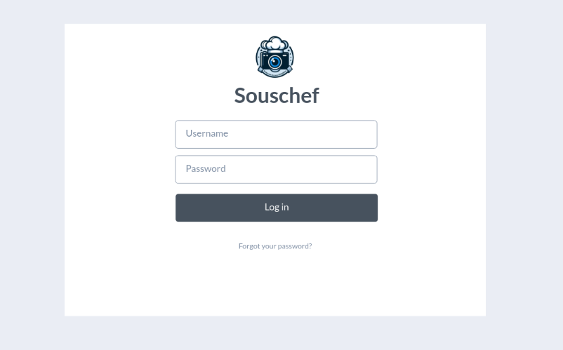
Log in Page
Insert username and password to access the service

Slide 49
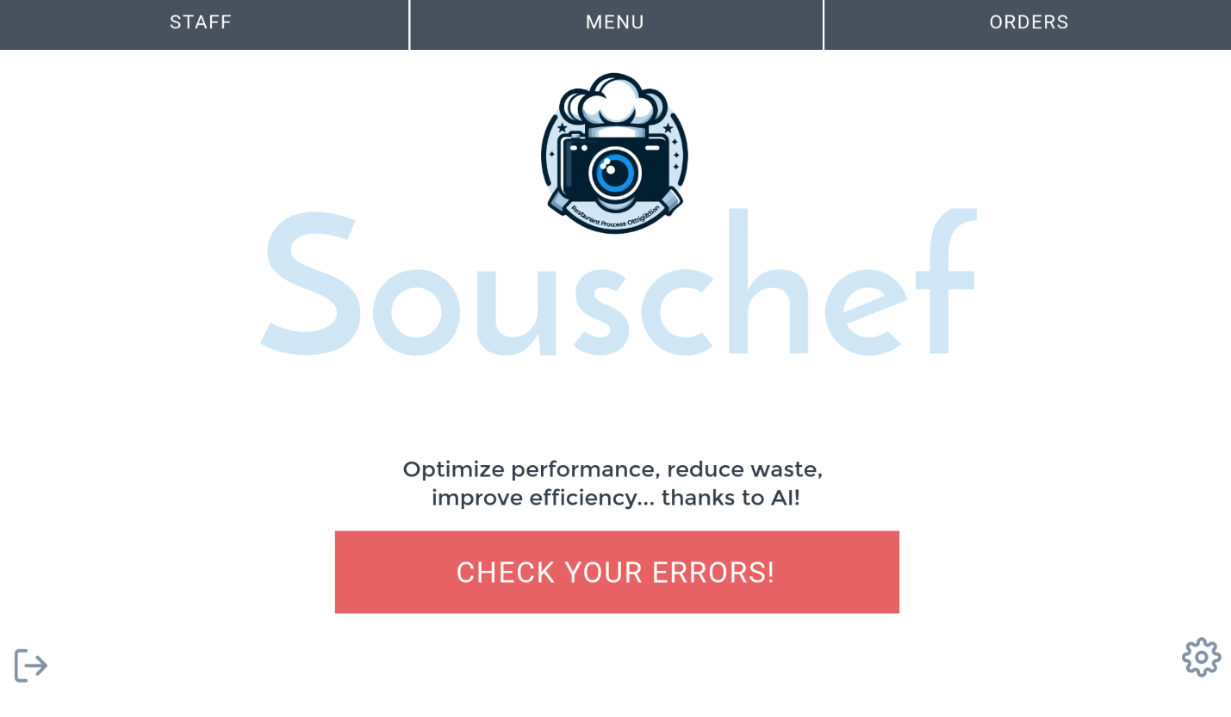
Main page
By clicking on “Check your errors!” you can have access to main feature of our Computer Vision based solution.
This is the main screen, form here you can have access to every section of the software.

Slide 50
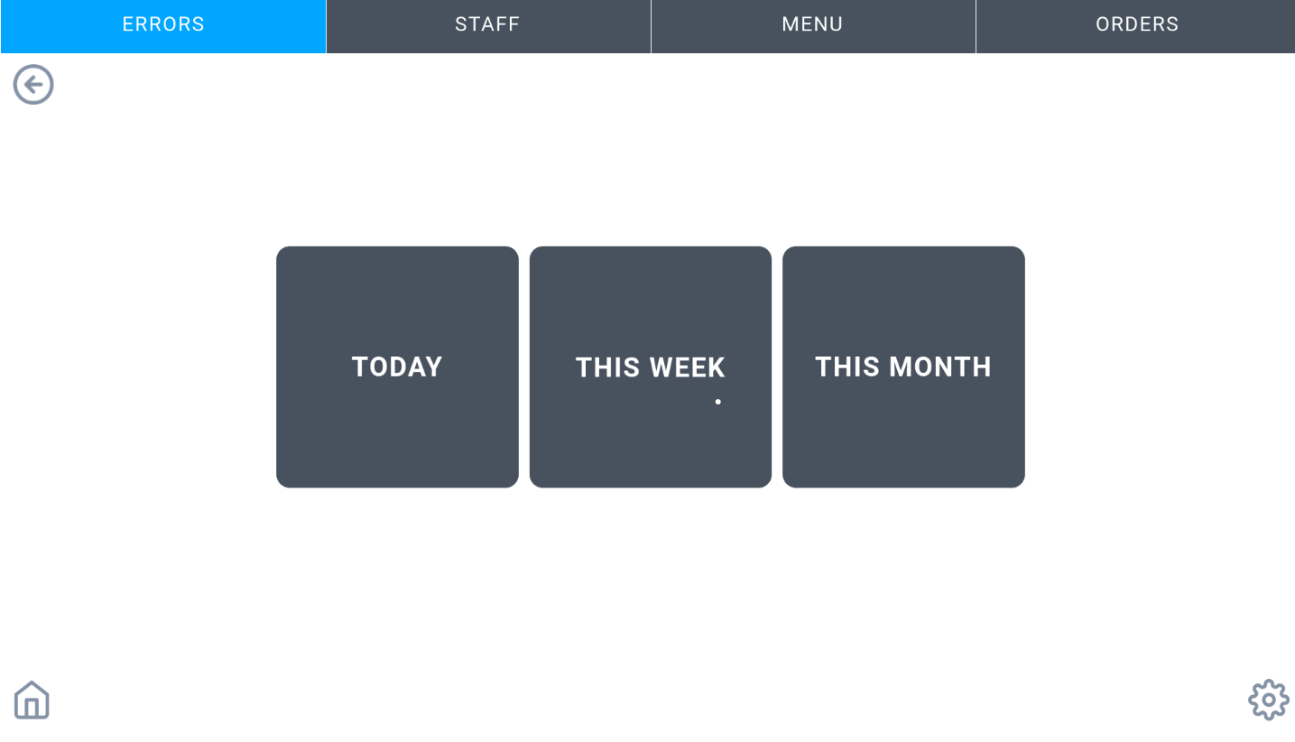
CHECK YOUR ERRORS!
From here, you can access the history of daily, weekly, or monthly errors. Let’s check today’s errors!

Slide 51
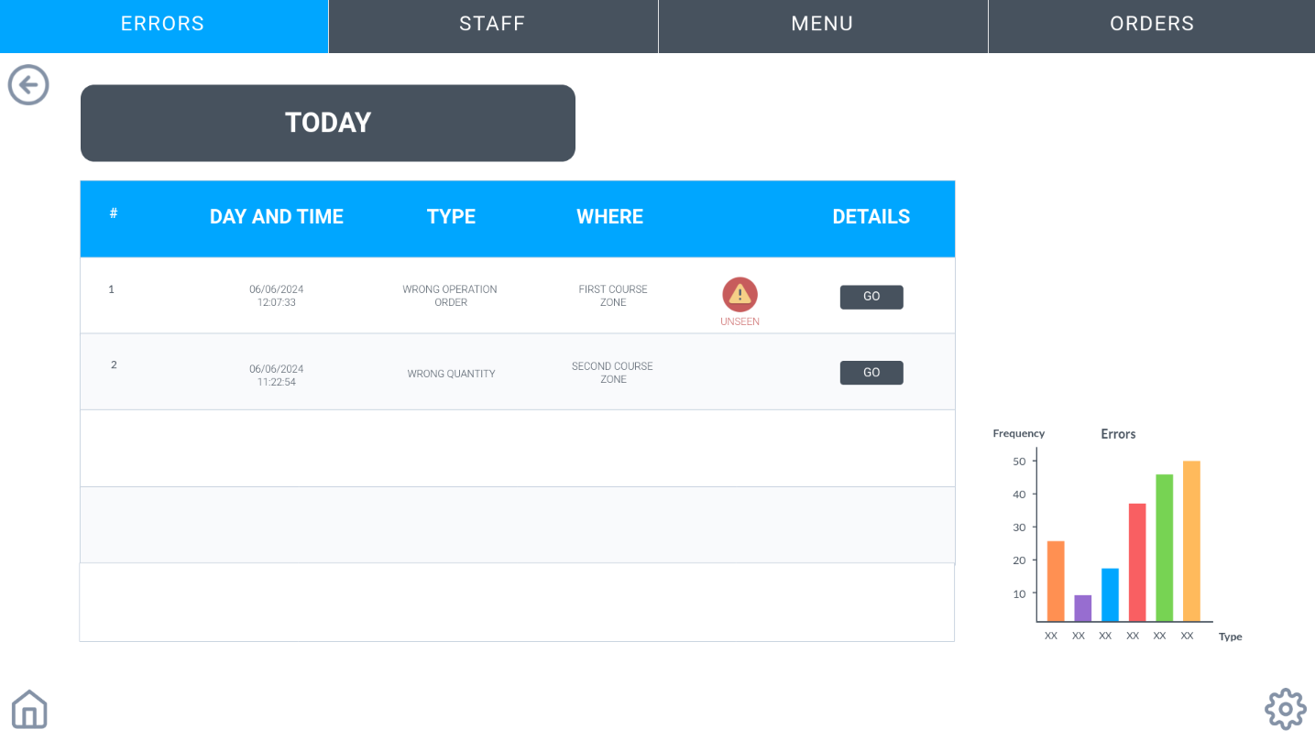
CHECK YOUR ERRORS!
For each error, the day and time of occurrence, the type of error, and the kitchen area affected are specified. Unviewed errors are marked with a special alarm signal. Let's check the first one by clicking on the "GO" button.

Slide 52
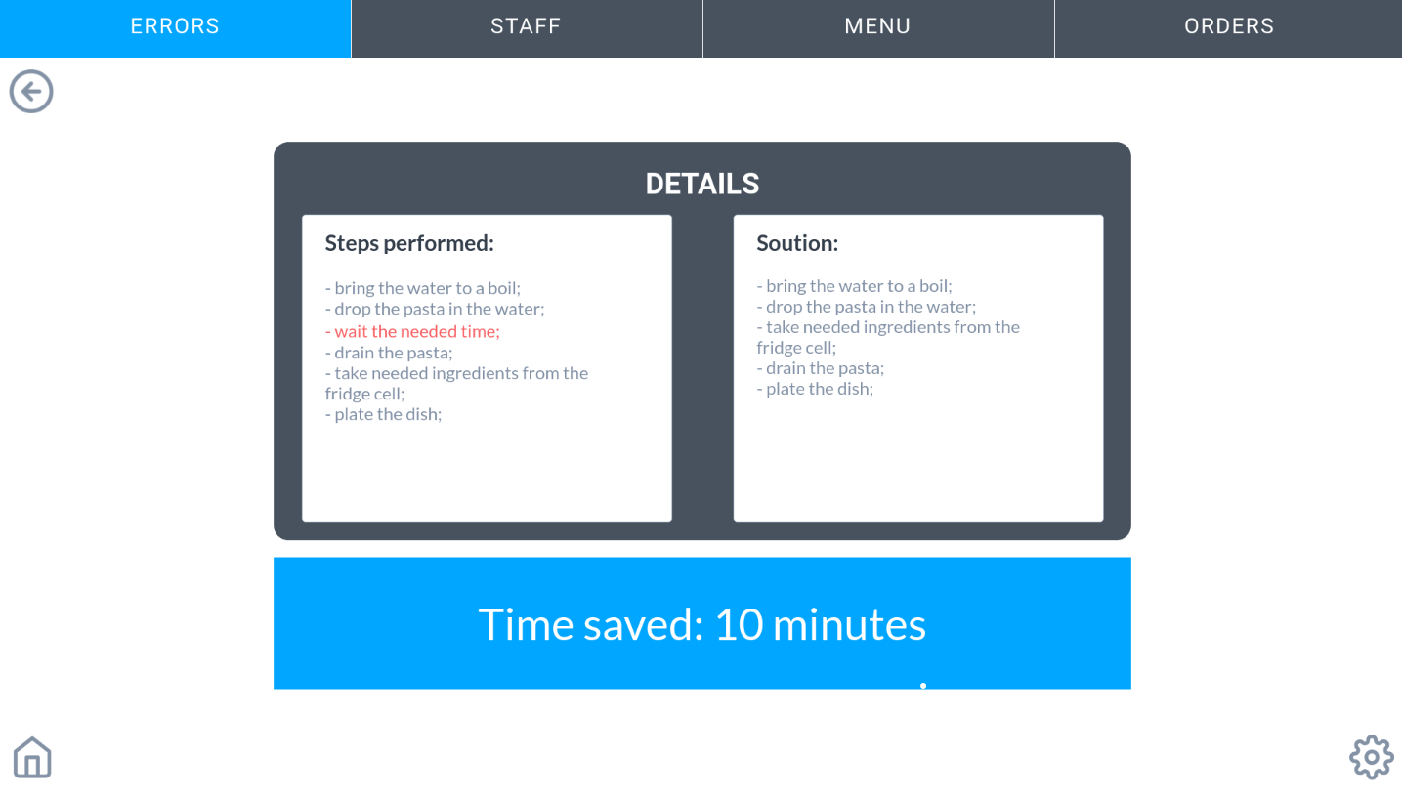
CHECK YOUR ERRORS!
The artificial intelligence system logs the steps performed, highlighting the error in red, and proposes the solution while calculating the saved time.
Now let’s check the staff section by clicking the top button

Slide 53
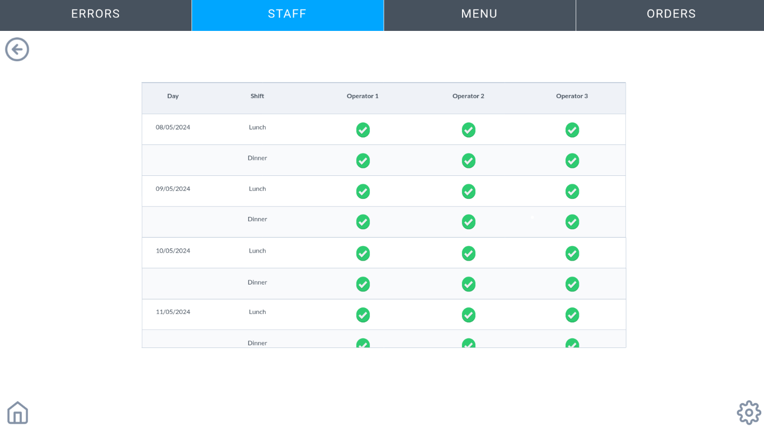
STAFF
From here, the personnel manager can check the availability of each employee for each shift on workdays. Let's now move to the Menu section by clicking on the appropriate button.

Slide 54
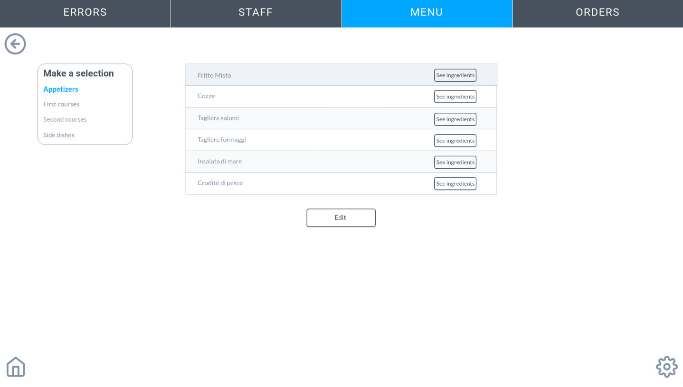
MENU
Using the selection box on the left, you can choose to view dishes based on their course type. By clicking the "Edit" button, you can add, remove, or change ingredients for individual dishes. For example, let's check the first courses by clicking on "First Courses."

Slide 55
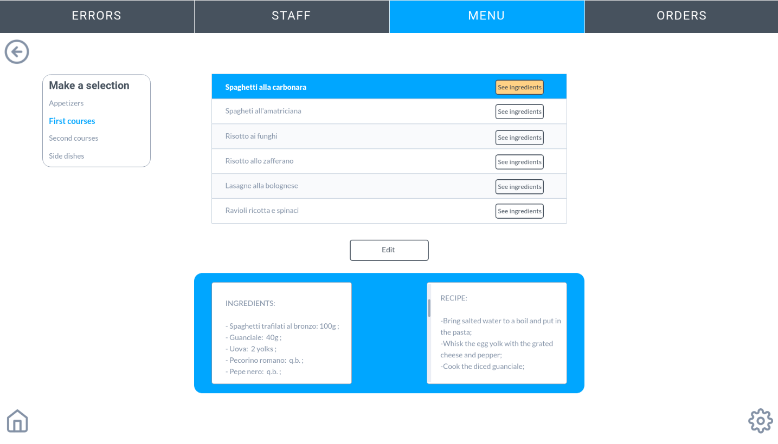
MENU
By selecting "See ingredients" for pasta alla carbonara, you can view both the list of ingredients and the recipe. Let's now move on to the "Orders" section.

Slide 56
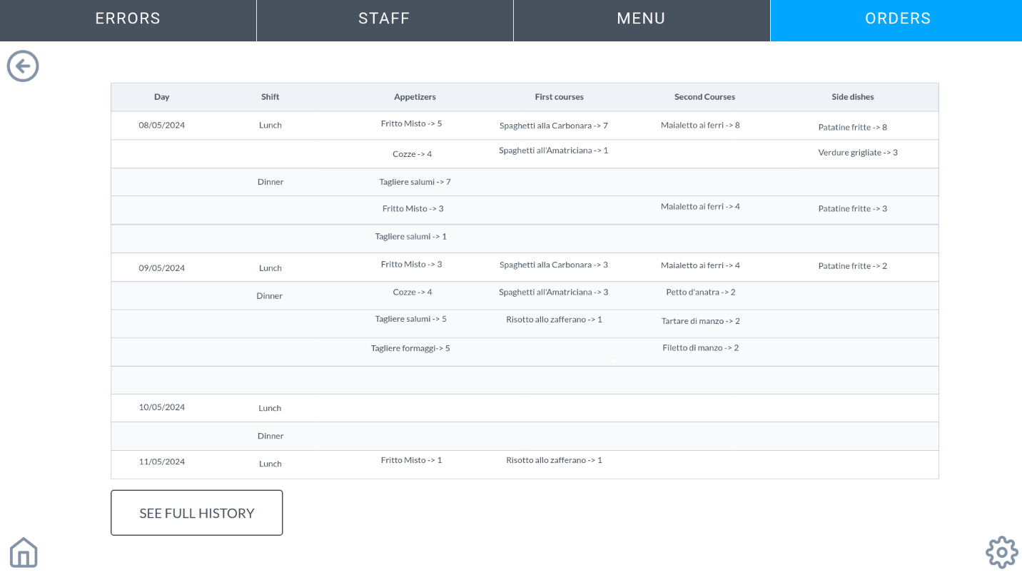
ORDERS
Here, you can view the dishes and their quantities for anticipated orders placed. Let's click on "SEE FULL HISTORY".

Slide 57
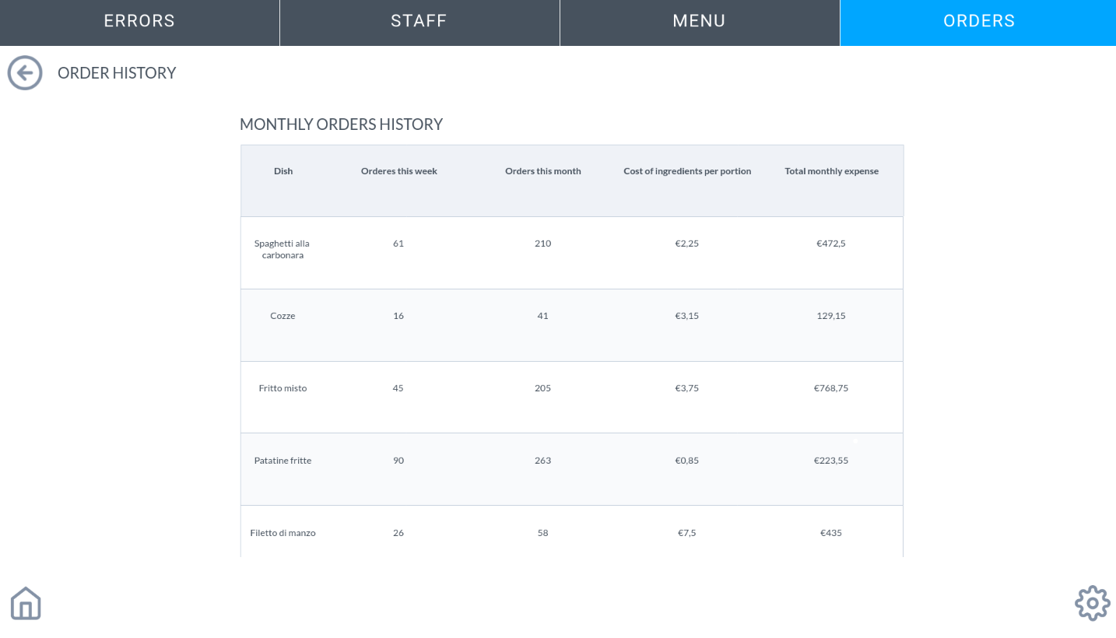
ORDERS
From here, you can see the ordered quantity of each dish over the past week and month. You can also see their respective costs per portion and monthly .

Slide 58
Market-Competition
To understand the potential of SousChef, a brief market value analysis was conducted:
TAM: Restaurant management software market
The market for restaurant management software is a very broad market that had an estimated value of $4.98 billion in 2022 and is expected to grow at a rate of 13.4%. This is because it is a competitive sector where restaurant businesses, especially those not in the “high-end” category like Michelin-starred restaurants, are forced to prioritize operational efficiency with the aim of reducing costs and staying in the market.
Source: Restaurant Management Software Market (2023 to 2029). (2023, giugno). MAXIMIZE MARKET RESEARCH.

Slide 59
Market-Competition
To understand the potential of SousChef, a brief market value analysis was conducted:
SAM: Full-service restaurants
The introduced market can be segmented based on the type of end user, including:
Full-service restaurants
Quick-service restaurants
Institutional
Others
In our case, as mentioned in the value proposition, the target customers are full-service restaurants.
This market segment is characterized by a market share of 30% of the total value, which corresponds to a value of $1.494 billion.
Source: Restaurant Management Software Market (2023 to 2029). (2023, giugno). MAXIMIZE MARKET RESEARCH.

Slide 60
Market-Competition
To understand the potential of SousChef, a brief market value analysis was conducted:
SOM
A company offering a service similar to ours is PreciTaste. This company operates in the United States and, as reported by various business databases, it is estimated that the company can generate annual revenues of about $4.4 million. Additionally, the company's website states that about 3000 computer vision systems have been installed.
Source:
https://growjo.com/company/PreciTaste
https://precitaste.com/

Slide 61
Market-Competition
To understand the potential of SousChef, a brief market value analysis was conducted:
SOM
According to the US Census Bureau as reported by Statista in its report, in 2022 alone, the restaurant industry in the United States generated a total revenue of $975.9 billion. According to a statement released by FIPE (Federazione Italiana Pubblici Esercizi), the restaurant market in Italy in 2023 generated a value of approximately $59 billion (€54 billion), or 6.04% of what was generated in the United States.
In Italy, considering the estimated revenues of PreciTaste, a startup like SousChef would be able to capture a value (in dollars) equal to:
R = 6.04% ∙ $4,400,000 = $266,010.86
Source: Statista
Fipe, Rapporto Ristorazione 2024: previsti investimenti green e digitali per 4 miliardi di euro - FIPE. (2024, 11 aprile). FIPE.

Slide 62
Business Model Canvas
Key activities
Customer relationships
Value proposition
Key partners
Customer segments
Key resources
Channels
Cost structure
Revenue streams

Slide 63
Business Model Canvas
Key activities
Customer relationships
Value proposition
Key partners
Customer segments
Key resources
Channels
Cost structure
Revenue streams

Slide 64
Business Model Canvas
Enhance operational efficiency through Computer Vision
Increase awareness of the optimal amount of food to be prepared
Improve staff performance
Minimize food waste
Decrease the impact of raw material costs on profit
Key activities
Customer relationships
Value proposition
Key partners
Customer segments
Key resources
Channels
Cost structure
Revenue streams

Slide 65
Business Model Canvas
Key activities
Customer relationships
Value proposition
Key partners
Customer segments
Key resources
Channels
Cost structure
Revenue streams

Slide 66
Business Model Canvas
Computer vision technology providers: the computer vision service is provided by an external company specialized in developing specific computer vision solutions. This choice was made because AI technologies, in addition to requiring significant expertise, need costly investments that are often challenging to sustain with the developement of only a single solution. Following discussions with the CEO of D/Vision LAB, a company specializing in computer vision solutions, it was strategically advantageous to procure computer vision services from a third party.
Universities and research institutes: Collaborating with universities
would assist SousChef in several areas:
1. Market research
2. Study of potential additional features for the software or
improvements
Researching common error patterns across multiple restaurants to
provide solutions for future clients
Key activities
Customer relationships
Value proposition
Key partners
Customer segments
Key resources
Channels
Cost structure
Revenue streams

Slide 67
Business Model Canvas
Key activities
Customer relationships
Value proposition
Key partners
Customer segments
Key resources
Channels
Cost structure
Revenue streams

Slide 68
Business Model Canvas
Key activities
Customer relationships
Value proposition
Key partners
Customer segments
Software development and maintenance: Development and programming of the software will be faithful to the prototype, guaranteeing integration with the data and statistics provided by the company handling the computer vision system. These statistics will be filtered and interpreted by the SousChef team, allowing for customized solutions to be made available to each customer.
We will also provide ongoing maintenance of the software.
Continuous feature updates
Marketing and sales: Crucial, especially in the initial period, to attract new clients.
Customer support and training
Key resources
Channels
Cost structure
Revenue streams

Slide 69
Business Model Canvas
Key activities
Customer relationships
Value proposition
Key partners
Customer segments
Key resources
Channels
Cost structure
Revenue streams

Slide 70
Business Model Canvas
Technical and Development Staff
Computer Vision Technology
Software Platform
Consultancy Staff: Dedicated personnel for the additional service of consultancy for clients who request it, and to support the company providing the computer vision system in training the specific AI to provide tailored solutions for the restaurant industry. For this reason, we believe that the Consultancy Staff should consist of individuals with experience in the restaurant field.
Databases for restaurants data: For each restaurant, it is necessary to allocate space in a database to store its data.
Key activities
Customer relationships
Value proposition
Key partners
Customer segments
Key resources
Channels
Cost structure
Revenue streams

Slide 71
Business Model Canvas
Key activities
Customer relationships
Value proposition
Key partners
Customer segments
Key resources
Channels
Cost structure
Revenue streams

Slide 72
Business Model Canvas
Intermediary for technical support between the customer and the Computer Vision system provider
Training services: Initial assistance service during the system installation phase and support for using the software.
24/7 customer support
Online support platform and community forum
Key activities
Customer relationships
Value proposition
Key partners
Customer segments
Key resources
Channels
Cost structure
Revenue streams

Slide 73
Business Model Canvas
Key activities
Customer relationships
Value proposition
Key partners
Customer segments
Key resources
Channels
Cost structure
Revenue streams

Slide 74
Business Model Canvas
Key activities
Customer relationships
Direct sales through the sales team
Company website and e-commerce
Industry trade shows and conferences: especially in the initial stages, it will be crucial to participate in numerous conventions and conferences to advertise the product and showcase its potential, overcoming tradion based biases.
Value proposition
Key partners
Customer segments
Key resources
Channels
Cost structure
Revenue streams

Slide 75
Business Model Canvas
Key activities
Customer relationships
Value proposition
Key partners
Customer segments
Key resources
Channels
Cost structure
Revenue streams

Slide 76
Business Model Canvas
Full-service restaurant chain managers
Full-service indipendent restaurant owners
Restaurateurs interested in reducing food waste and improving operational efficiency
Key activities
Customer relationships
Value proposition
Key partners
Customer segments
Full-service restaurants are places where every meal is an experience, conceived through careful attention to detail, personalised care from the staff, and a diverse menu in a setting designed for your enjoyment. This type of restaurant was chosen as the target customer for SousChef because it is the most diffused in Italy and currently lacks a comparable service to what SousChef offers. High-quality restaurants, such as Michelin-starred ones, were excluded because aspects like service speed and food waste reduction are less critical compared to a mid-range to lower-end restaurant, given the nature of the service they provide.
Key resources
Channels
Cost structure
Revenue streams

Slide 77
Business Model Canvas
Key activities
Customer relationships
Value proposition
Key partners
Customer segments
Key resources
Channels
Cost structure
Revenue streams

Slide 78
Business Model Canvas
Key activities
Customer relationships
Value proposition
Software development and maintenance costs
Salaries for technical and support staff
Marketing and customer acquisition expenses
R&D investments related to the activities done by universities and research centers
IT infrastructure costs (servers, PCs, etc.)
Key partners
Customer segments
Key resources
Channels
Cost structure
Revenue streams

Slide 79
Business Model Canvas
Key activities
Customer relationships
Value proposition
Key partners
Customer segments
Key resources
Channels
Cost structure
Revenue streams

Slide 80
Business Model Canvas
Key activities
Customer relationships
Annual fee: annual fee to pay to keep the service active.
Initial subscriptions & Cameras Installation: initial fee to be paid only for subscribing to the service and installing the computer vision system devices.
Upsell of advanced modules or features: revenue related to the sale of additional, more advanced monitoring devices
Additional consultancy services: revenue related to the optional additional service of in-person consultation provided by the SousChef consultancy staff
Value proposition
Key partners
Customer segments
Key resources
Channels
Cost structure
Revenue streams

Slide 81
Financial Plan - Costs
Name | Type | Sinked | Fixed | Variable | Value
Computer Vision Hardware | Key Resources |  |  |  | 5,000 €
Computer Vision Software License | Key Resources |  |  |  | 50,000 €
Software Platform-Initial Development | Key Resources |  |  |  | 20,000 €
Technical & Development Staff | Key Resources |  |  |  | 200,000 €
Consultancy Staff | Key Resources |  |  |  | 100,000 €
Database for reservation forecast | Key Resources |  |  |  | 500 €
Software Development & Maintenance | Key Activities |  |  |  | 0 €
Continuous Feature Updates | Key Activities |  |  |  | 0 €
Customers Supporting Training | Key Activities |  |  |  | 0 €
Marketing & Sales-Campaigns | Key Activities |  |  |  | 50,000 €
Marketing & Sales-Sales Team | Key Activities |  |  |  | 80,000 €
Computer Vision Technology providers | Key Partners |  |  |  | 0 €
University and Research institutes | Key Partners |  |  |  | 30,000 €
IT Infrastructure Cost | Cost Structure |  |  |  | 15,000 €
Total |  | 35,000 € | 510,000 € | 5,500 €

Slide 82

Financial Plan - Revenues
Name | Type | Una tantum | Annual | Value
Initial Subscription & Cameras Installation | Revenues Stream |  |  | 7,000 €
Annual fee | Revenues Stream |  | 0 | 3,000 €
Additional Consultancy Service | Revenues Stream | 1 |  | 5,000 €
Upsell of advanced modules or features | Revenues Stream | 1 |  | 1,000 €
Total |  | 7,000 € | 3,000 €
Attention: the two optional features (Additional Consultancy Service and Upsell of advanced modules or features) are not included in the total calculation.

Slide 83

Financial Plan – Margin for each solution
Standard package
Optional
Name | Value
Initial Subscription & Cameras Installation | 7,000 €
Annual fee | 3,000 €
 | 10,000 €
Name | Value
Additional Consultancy Service | 5,000 €
Upsell of advanced modules or features | 1,000 €
 | 6,000 €
First year margin per restaurant
4500 €
After first year margin per restaurant
3000 €

Slide 84
Financial Plan – Estimated profits
We have estimated that in avarage a Restaurant in Italy has a food waste impact of 66.000€.
In avarage a Computer Vision System allows restaurants to reduce food waste by 42%. So 66.000€ x 42% = 27.720€
Let's assume we set a price of €10000 (for the first year) for our solution because:
a) Cost savings around 27.720€ by the reduction of food waste
b) Cost savings due to improved operational efficiency
c) High initial investment
107 customers in the first year (10% purchase full optional) are needed in order to reach BEP within the first year.
Customers = 545k€ / ( 0,1 x 16k€ + 0,9 x 10k€ - 5,5k€)
It is necessary to find an investor who can bring in capital between 500k€ and 1mln€
Source: Cibo sprecato in Italia: le regioni che ne buttano di più. (2024, 7 aprile). QuiFinanza.
Albrecht, C. (2020, 30 luglio). Phood Fights Food Waste with Scales, Computer Vision and AI. The Spoon.

Slide 85
Roadmap for future development
Future plans include various developments aimed at expanding the customer base by attracting them with new features.
Improvement of energy efficiency: Ai based energy-saving and energy use optimization solutions for the restaurant.
Expand the customer base:
Adapt the solution to bars, fast food restaurants and catering
Expand to foreign markets

Slide 86
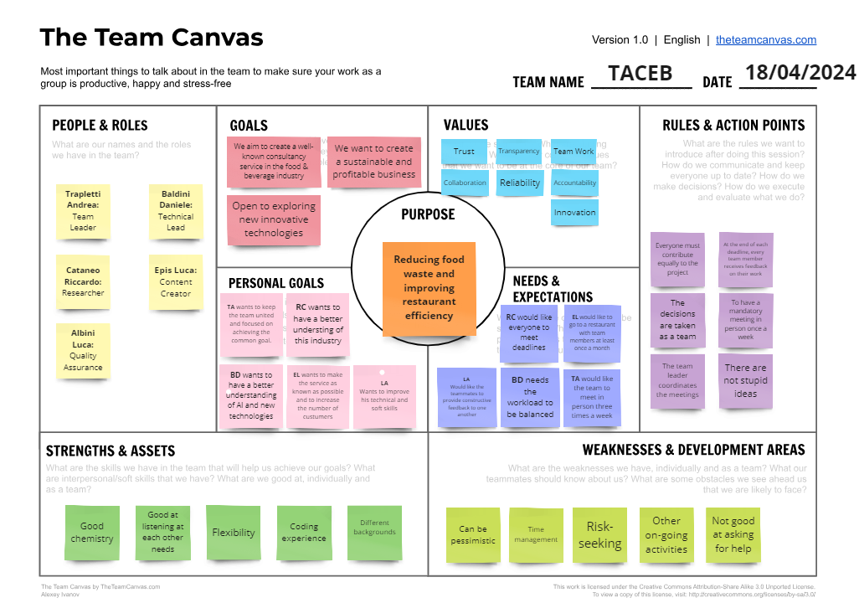
Appendix

